Slide 1
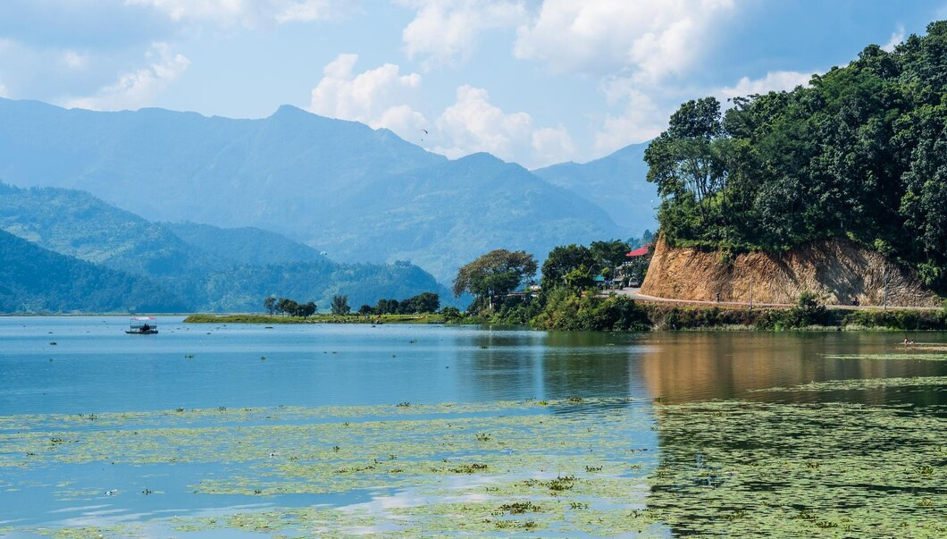
Phewa Lake

Slide 2



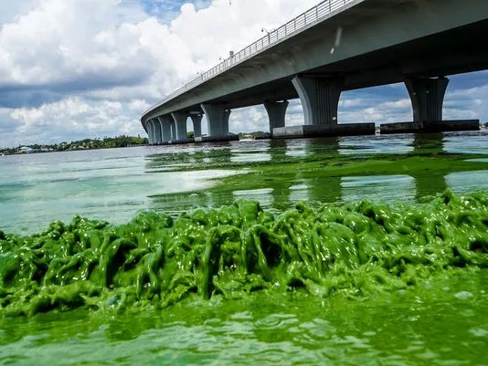

What is Algae?
Predominantly Aquatic
Photosynthetic

Slide 3










PROBLEM 1
Eutrophication
Problem
PROBLEM 2
Hypoxia
PROBLEM 3
Skin Irritation

Slide 4


Algenol
PREPARED BY TEAM ANONYMOUS

Slide 5

PROBLEM 1
Mitigation
Algenol
PROBLEM 2
Prevention
PROBLEM 3
Elimination

Slide 6
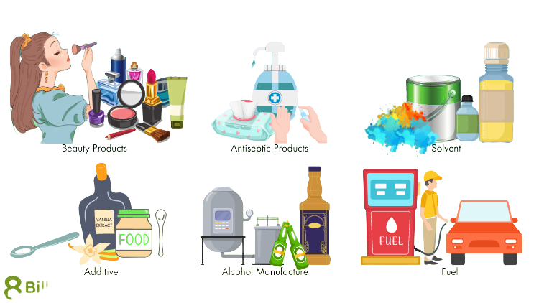

Beauty Product
Antiseptic
Product
of service
Addictive
Alcohol
Ethanol
Solvent
Fuel

Slide 7
CULTIVATION
Carbohydrate extraction
Hydrolysis
Production
Fermentation
Distillation
Dehydration
Store and Use

Slide 8

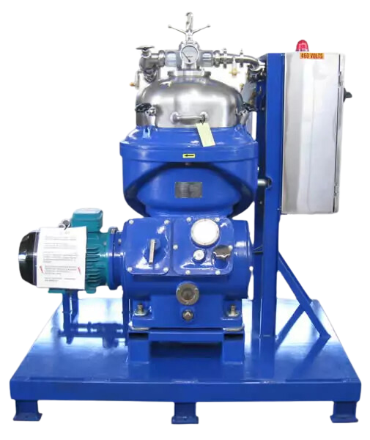
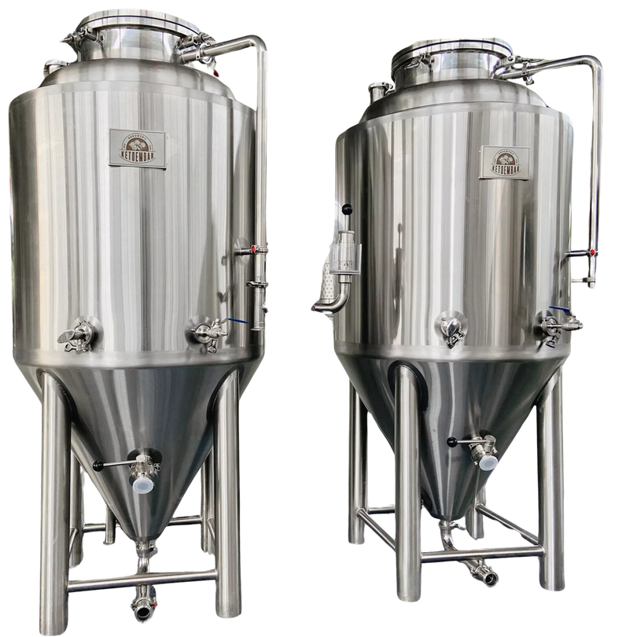
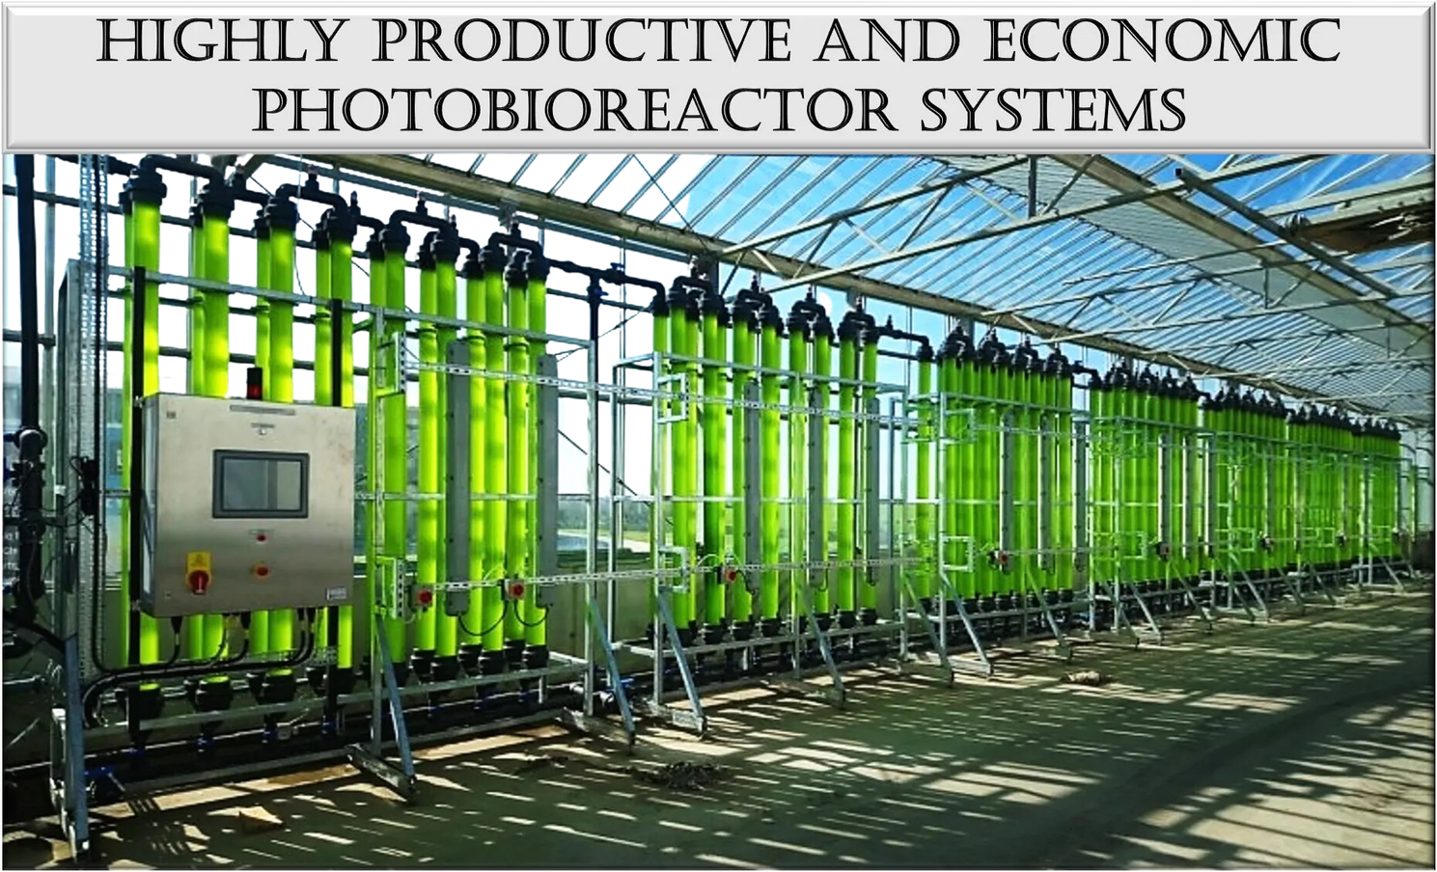
Machinery
Fermentation Tank
Centrifuge
photobioreactor
100L
$4,000.00-4,500.00
US$3,000.00-3,500.00
US$1,000-$10,000

Slide 9


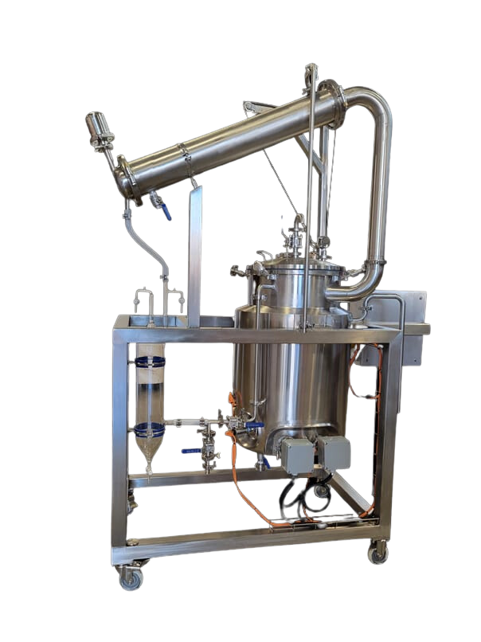
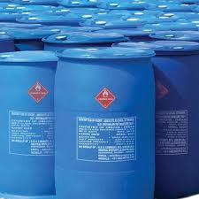
PACKAGING
DISTILLER
US$0.25-$5
US$5,000-$5,500
Total: US$18505
NRP 2516680

Slide 10




USD 93.62B in 2023
size of the
Total Available
Market (TAM) in World
US$4.32M with 26%per year growth year
USD$43.2M
market
Total Market size in Nepal
Serviceable Obtainable
Market (SOM)

Slide 11

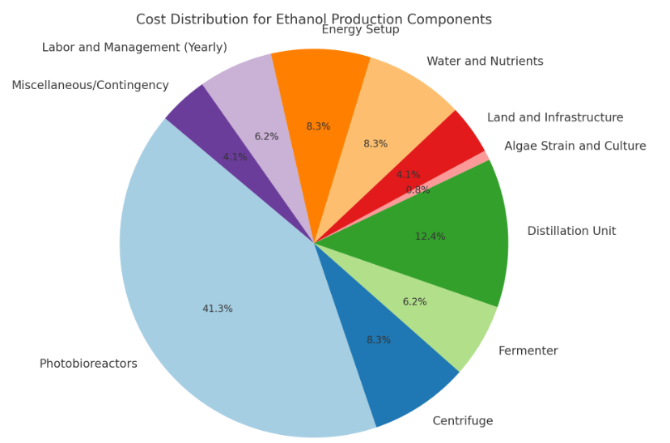
Investment
for $1m dollar revenue

Slide 12

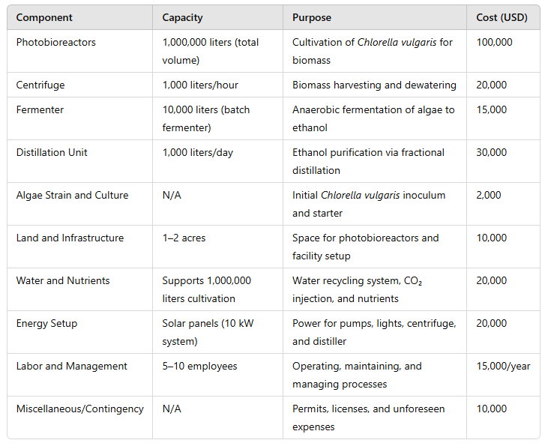


INVESTMENT

Slide 13
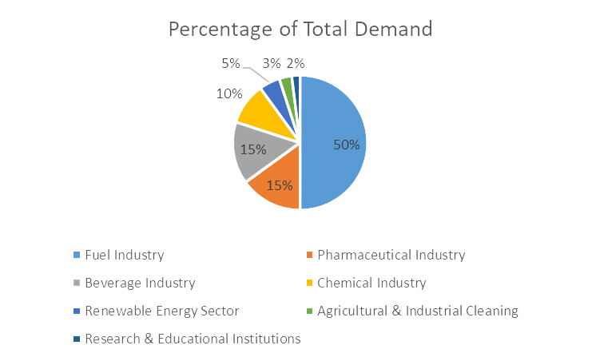
Market
Size in Nepal

Slide 14

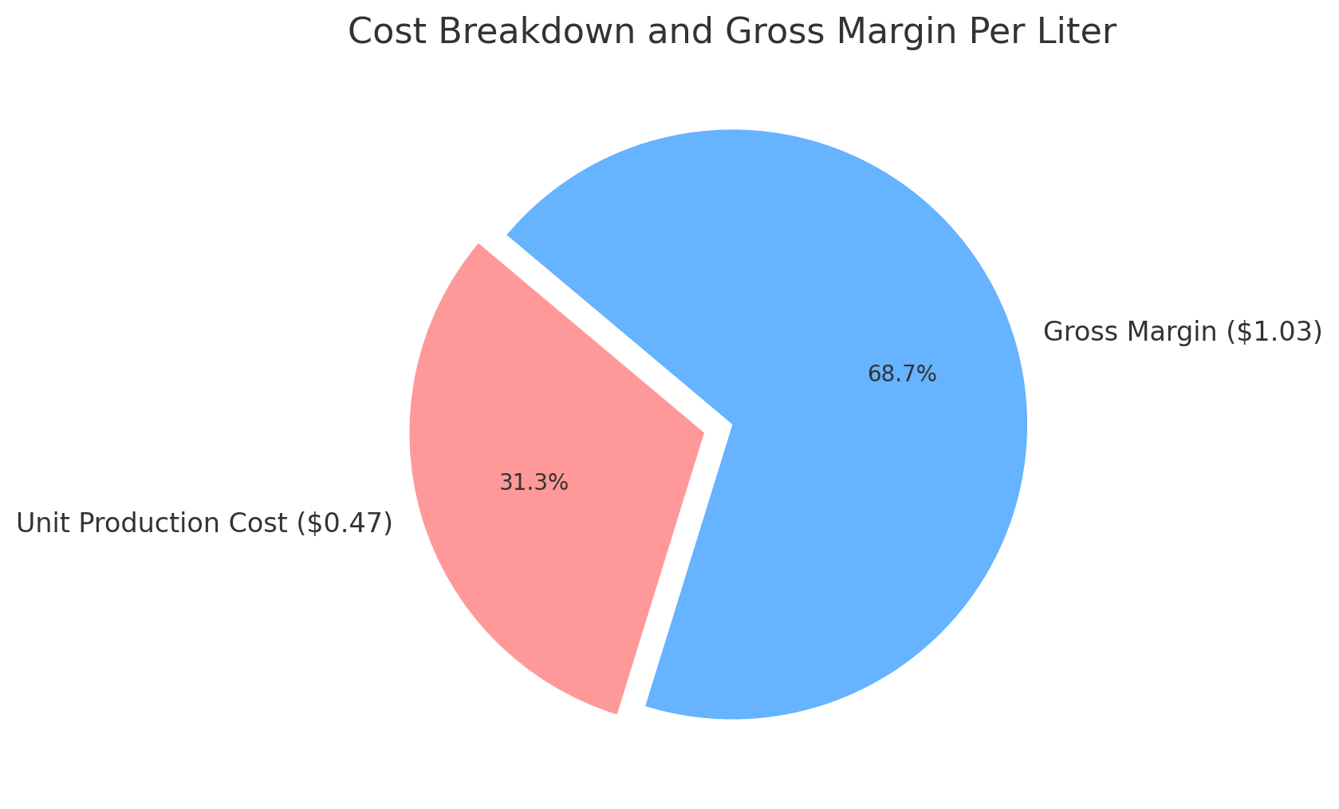
Unit Economics
Gross margin = 68.76%

Slide 15




Business Startegy
Core Activities
Revenue Streams
Cost Structure
Grow algae
Ethanol sales
Setup
Harvest and process algae
By-product utilization
Operational
Refine ethanol
Carbon credits
Logistics

Slide 16


Key Partnerships
Challenges
Scalability and Future Outlook
Government
High production costs
Tech investments to lower costs and boost efficiency
Fuel distributors
Competition with other fuel sources.
Increasing renewable energy demand
Research institutions

Slide 17



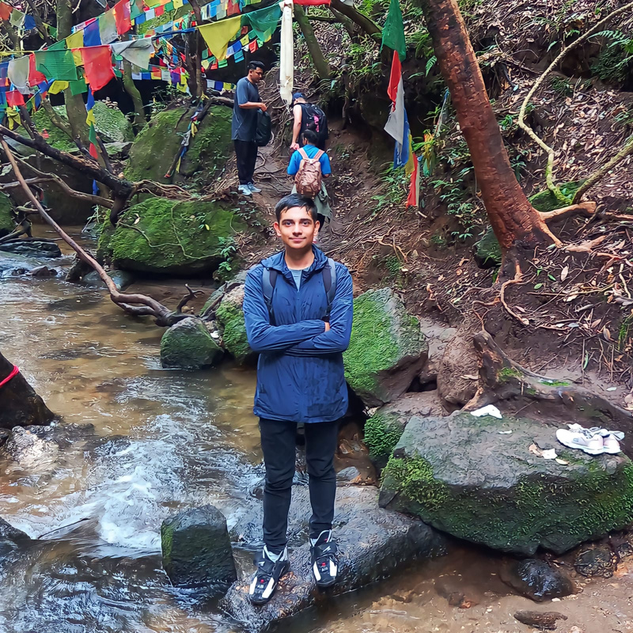
THE
team
RUBY | CE0
AASHIKA | FINANCE MANAGER
Anonymous
SUSHIL | FOUNDER
SUSHANT | CFO

Slide 18

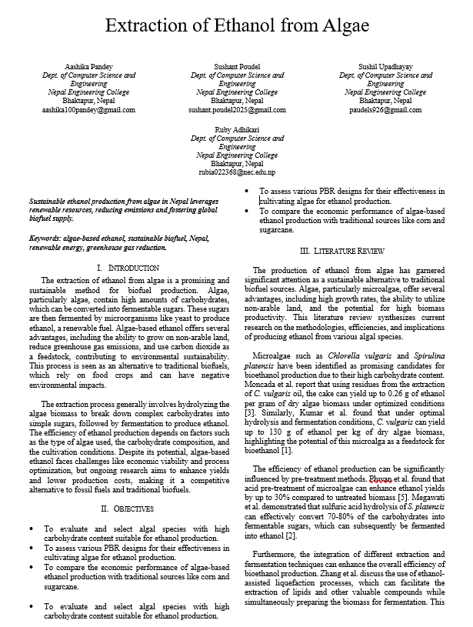
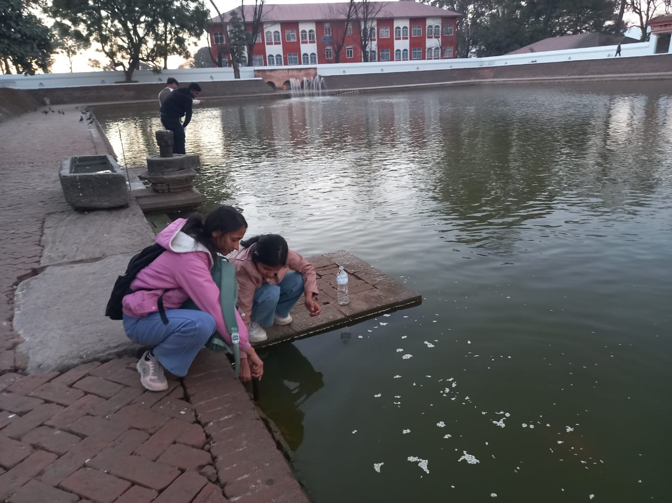
for further details refer to the following research conducted by our team
https://docs.google.com/document/d/1gq9aHE5aUYyn9fIKL4-Zh3QbdvLzqqX5/edit?usp=drive_link&ouid=117845239992833854296&rtpof=true&sd=true
Collecting algae from polluted water

